Slide 1
Analyzing spatial models
AIMS April 3

Slide 2
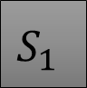
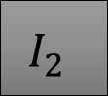
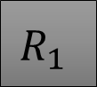

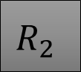


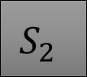

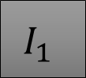


Two ways of modeling movement
“Eulerian” movement
“Lagrangian” movement
$$S_{1}$$
$$I_{1}$$
$$R_{1}$$
$$S_{1}$$
$$I_{1}$$
$$R_{1}$$
$$S_{2}$$
$$I_{2}$$
$$R_{2}$$
$$S_{2}$$
$$I_{2}$$
$$R_{2}$$
Moves people from place to place, transmission only within patch
People stay at resident location, get exposed to others

Slide 3
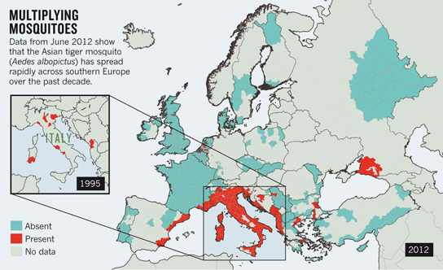

What can you do with these models?
These models useful when your research question are spatial
Some places differ
Account for transmission rates in different areas
Mosquitoes in some areas but not others
Account for emergence and spread
Account for different policies

Slide 4
Learning objectives
Understand what is often observed in spatial models
Stochastic extinction: Why does this happen? What is the role of “synchrony”?
Network dynamics: What is a “central” node?
Source-sink dynamics
Wave dynamics: What is a “wave”? What dictates how fast the wave moves?

Slide 5
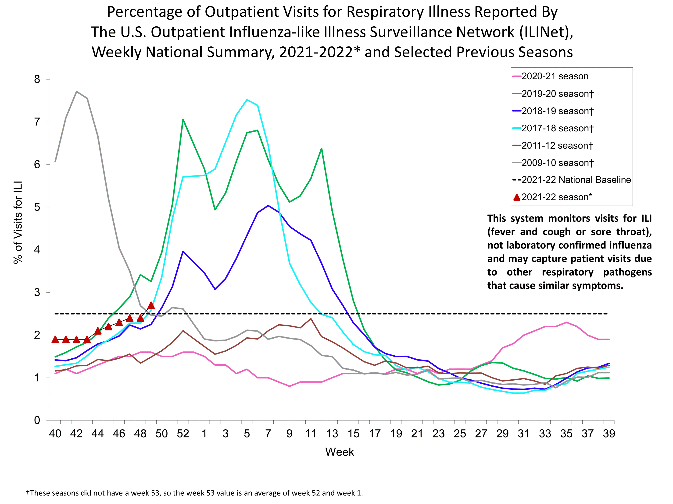
Lagrangian movement: Local scale
Spread of influenza-like illness in London, through Underground
Islington: Less connected, longer trips
Kensington/Chelsea: More connected
Do longer trips correlate with more ILI?
https://ehjournal.biomedcentral.com/articles/10.1186/s12940-018-0427-5

Slide 6
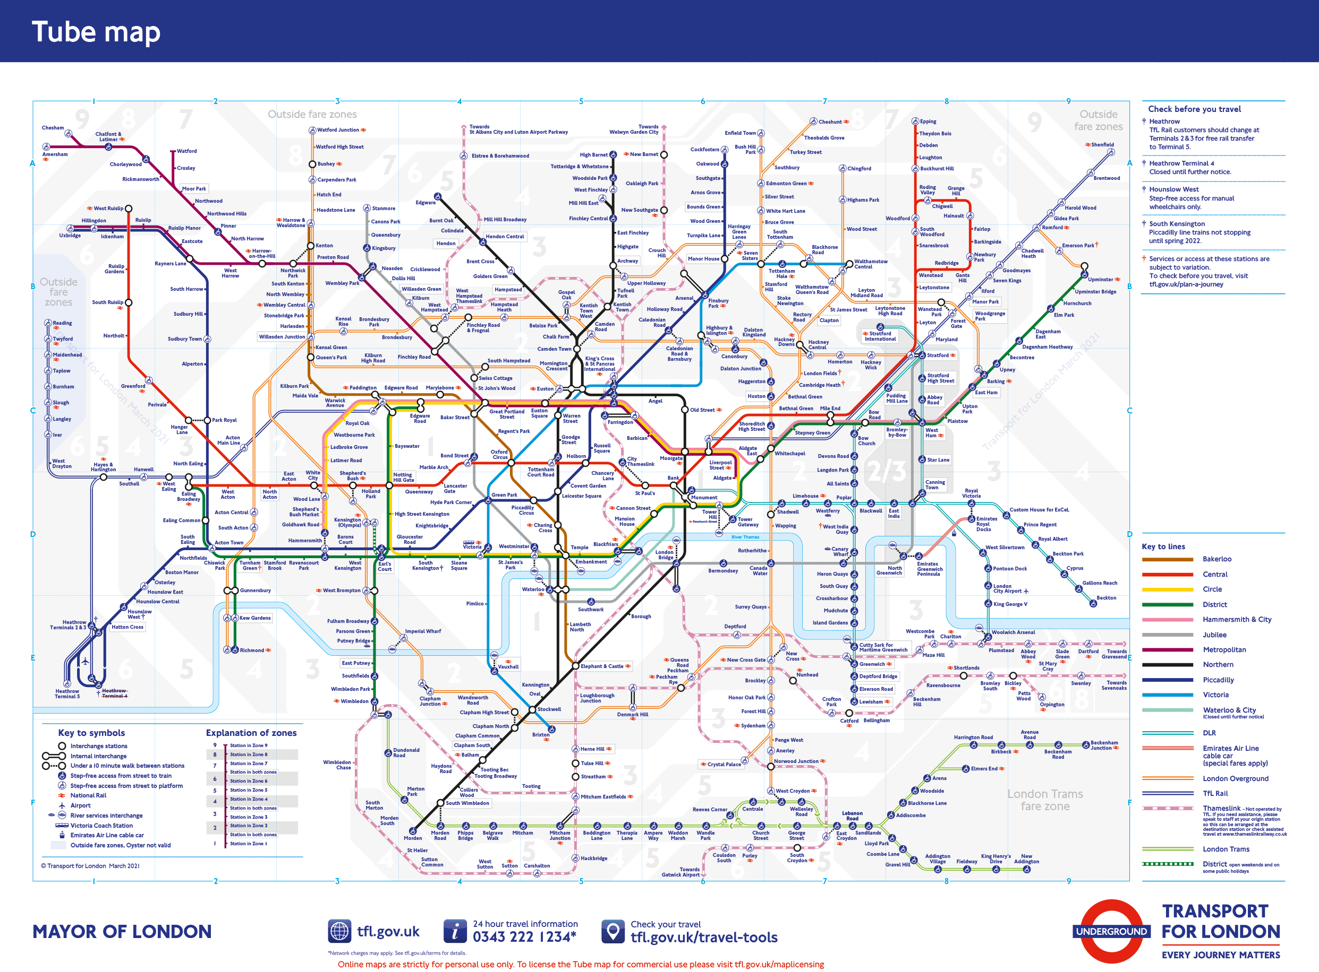

Slide 7
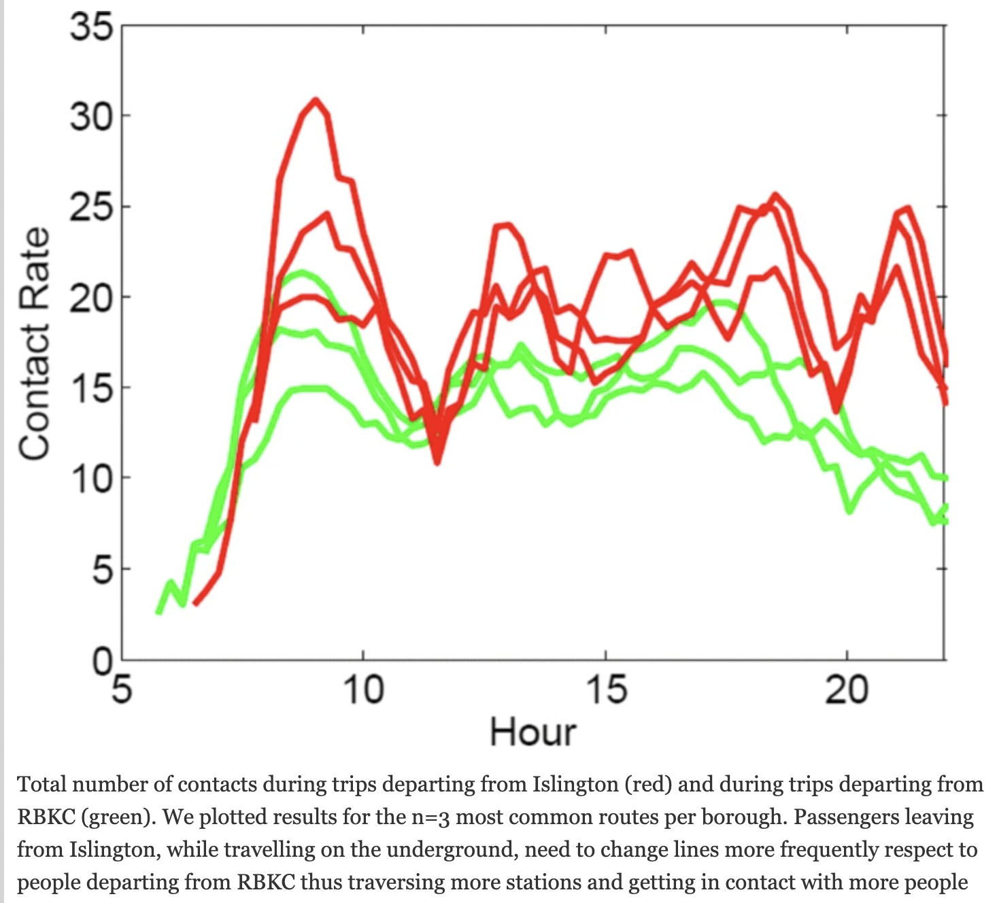
Lagrangian movement
Compared transmission predictions based on differences in contacts
Found positive correlation between underground contacts and ILI (correlation = .44, p=.0293)
People traveling from Islington had more contacts

Slide 8
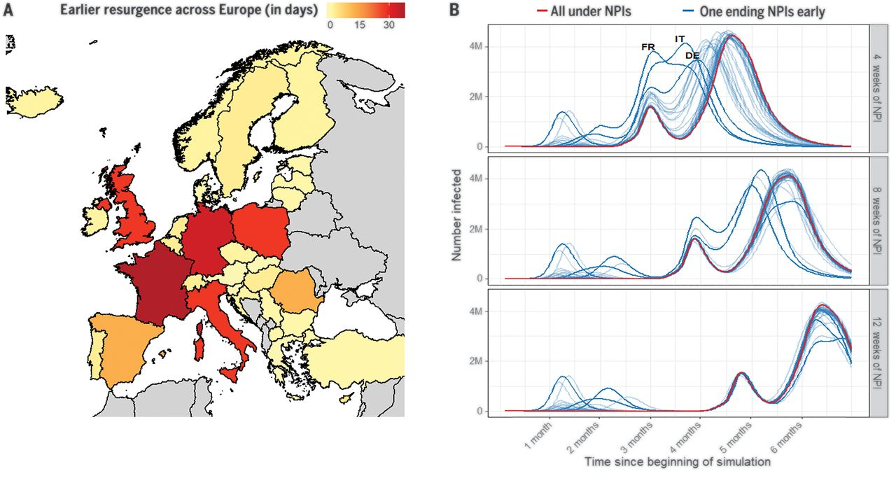
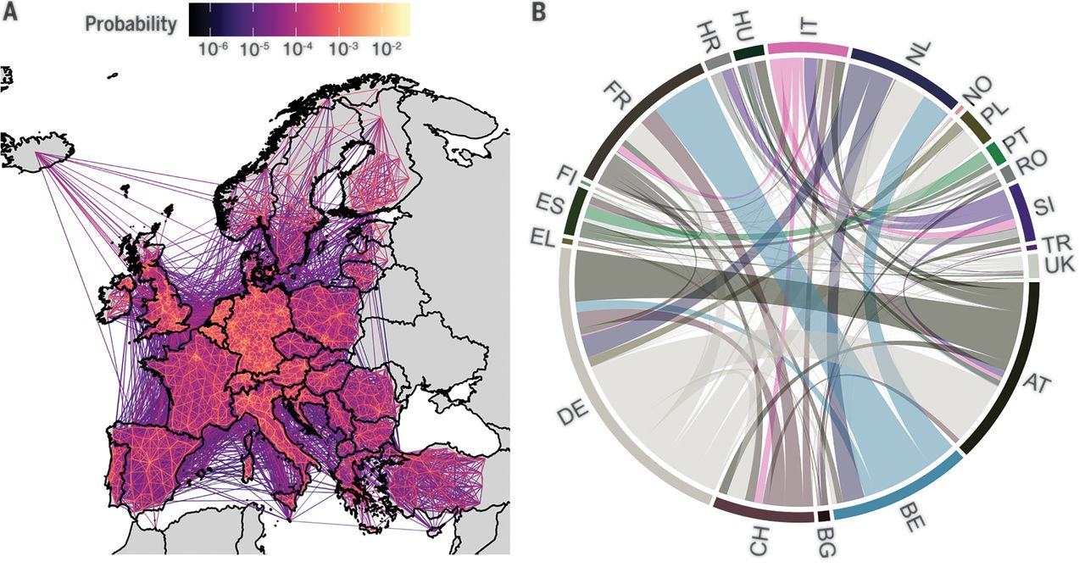
Eulerian movement

Slide 9
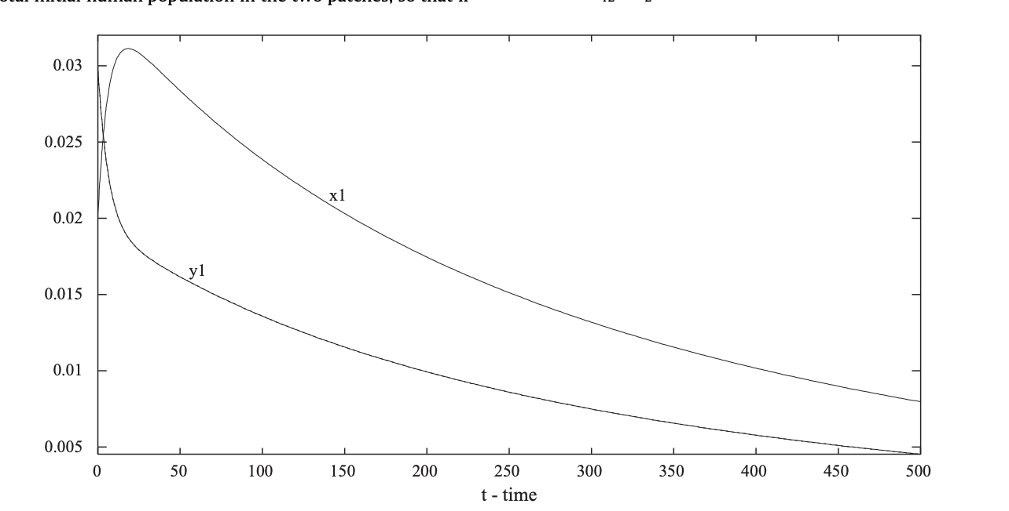
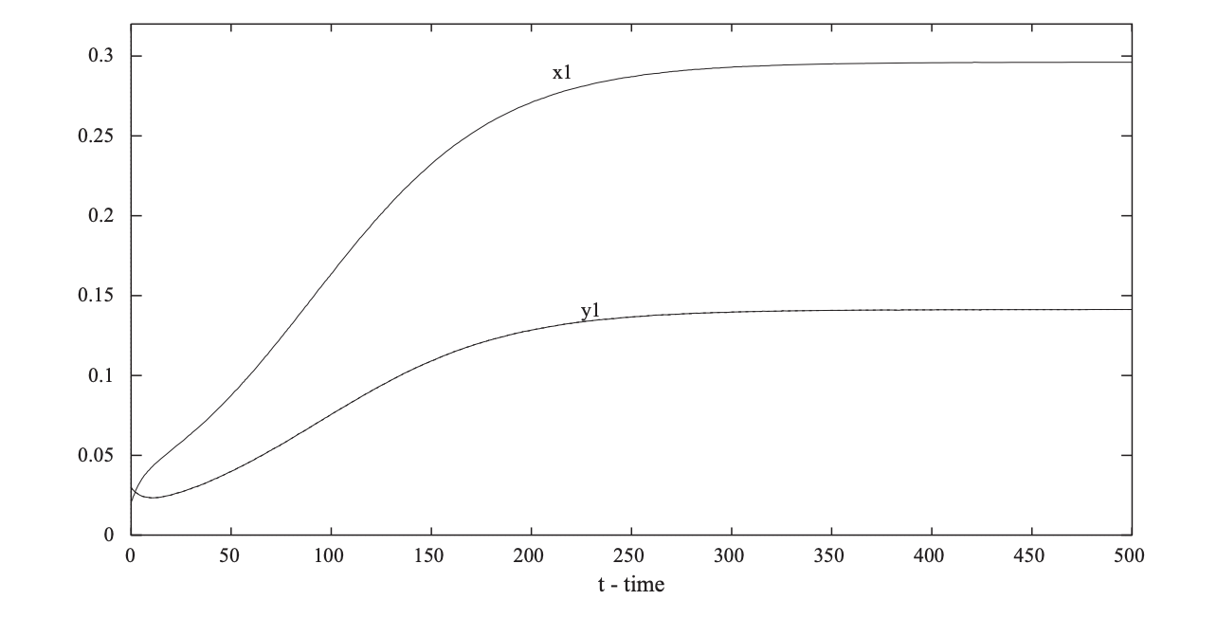
Eulerian movement
The effects of human movement on the persistence of vector-borne diseases
Also used in theoretical models; easier to analytically solve

Slide 10
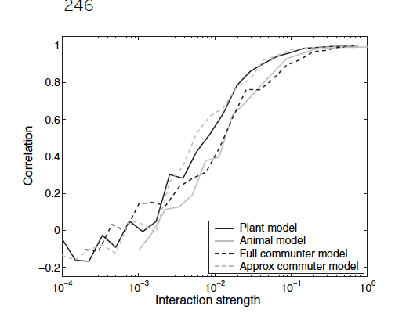
What do we observe in spatial models?
More strongly connected, the more synchronized their epidemics
Disease becomes more likely to die out: “Stochastic extinction”
Network/wave dynamics: Key nodes

Slide 11
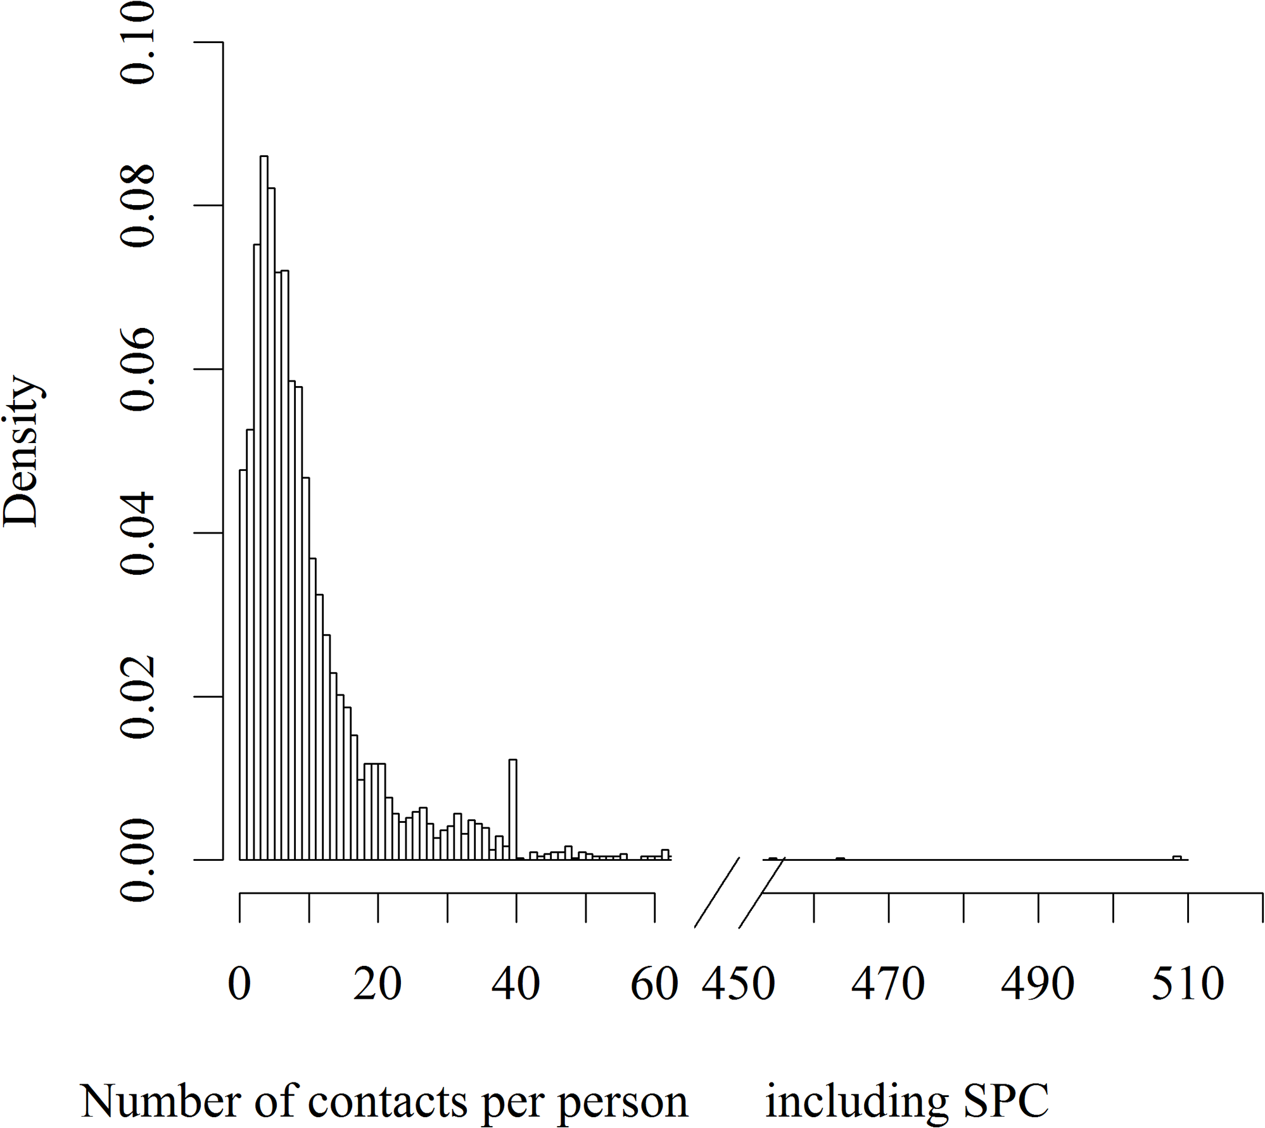
Stochastic extinction
Randomness is a huge driving factor in epidemic spread
Especially in small populations
Small numbers infected = more likely to infect all people with few contacts/people who recover quickly
Can cause localized extinction even when R0 > 1

Slide 12
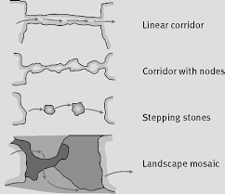
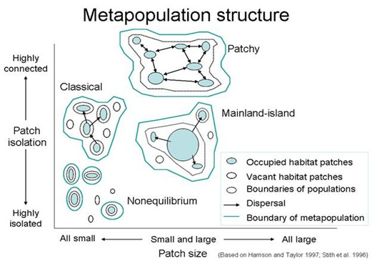
”Metapopulation” dynamics
Common issue in ecology—fragmented landscapes mean species more likely to die out
Opposite concern in disease
Can we take advantage of increased extinction likelihood?

Slide 13
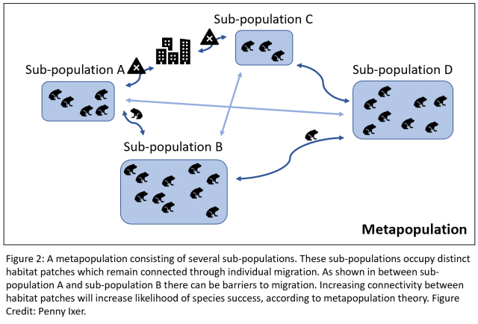

Slide 14
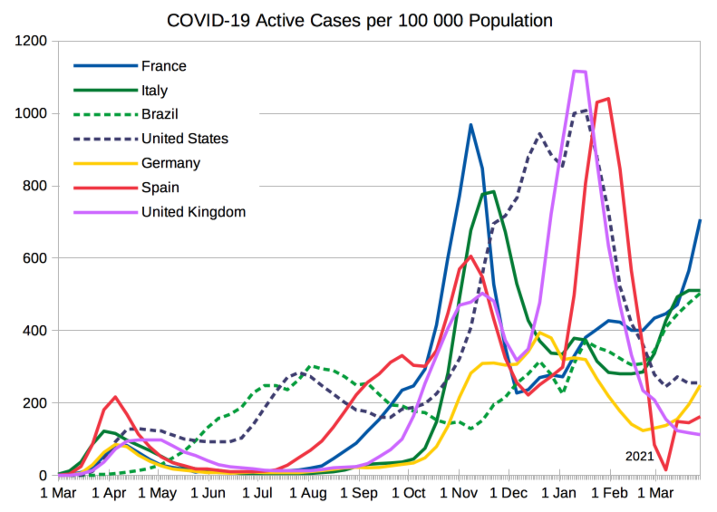

Slide 15
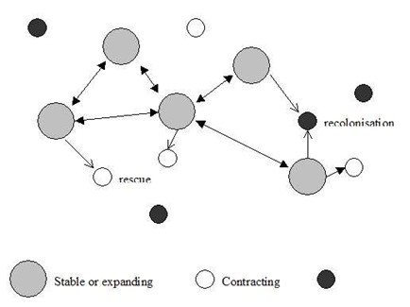
Source/sink dynamics
Commonly, some areas are higher transmission than others; net exporters of cases
Some are sustained only by importation; net importers

Slide 16
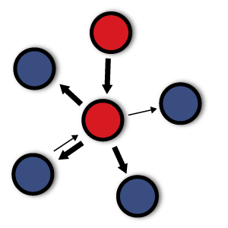
Source-sink dynamics
Sources: Areas that export cases, and lead to an outsized effect on transmission
Very effective intervention targets
Sinks: Import cases, would not have cases if not for importation
Surveillance targets

Slide 17
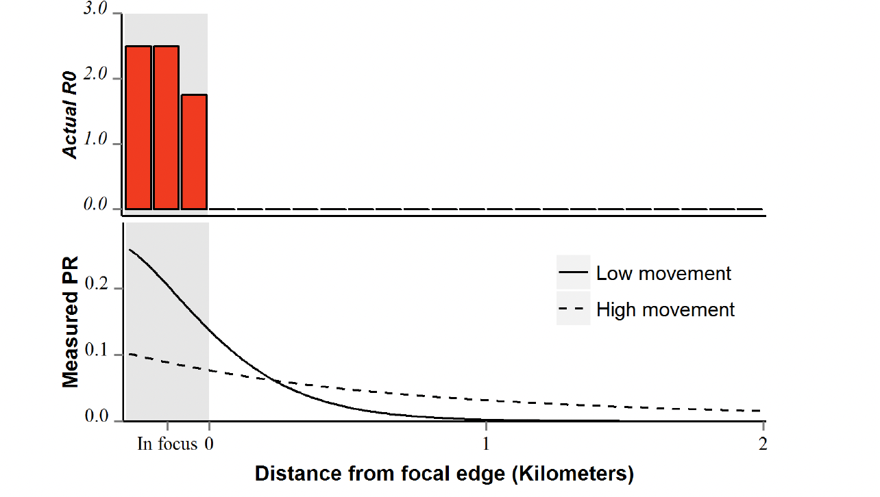
“Focal” transmission

Slide 18
Metapopulation dynamics
Sources and sinks are not always static
Some areas will be “expanding” or ”stable”, others contracting
When might we expect a shift between source/sink?
For respiratory disease?
For malaria?

Slide 19
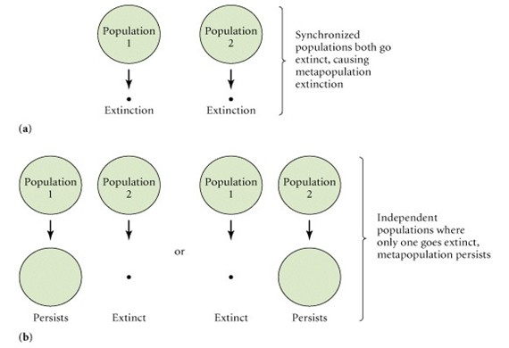
Synchrony/asynchrony
If populations are synchronized, more likely that extinctions will happen at the same time
High synchrony: global extinction possible
Low synchrony: Regional persistence

Slide 20
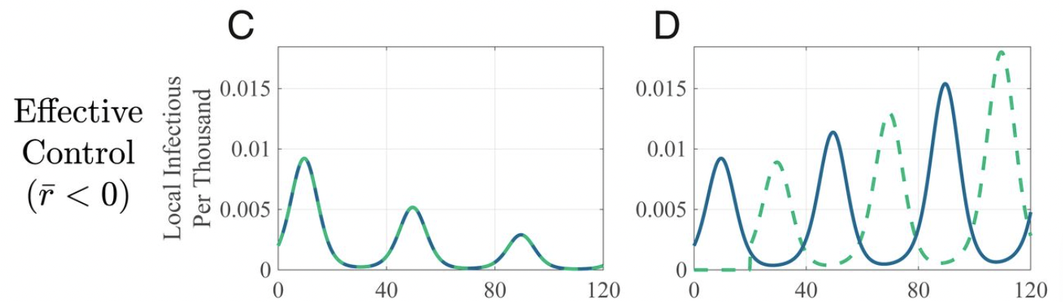
Timing control makes a big difference
Different interventions can induce “synchrony”/”asynchrony”
Everybody under self-isolation at the same time
Seasonality in behavior can, too
https://www.pnas.org/content/117/48/30104

Slide 21
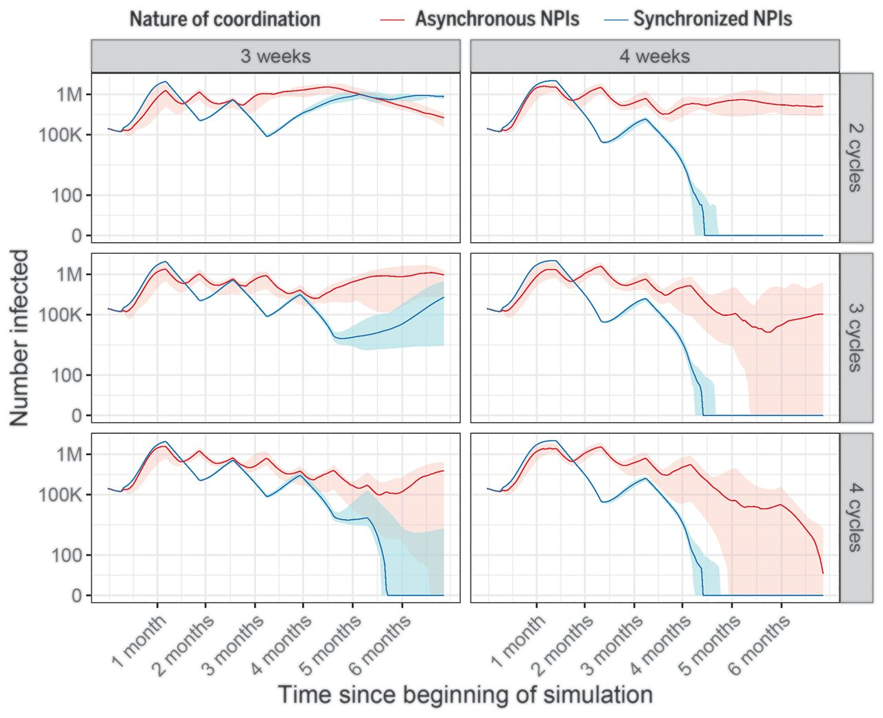

Slide 22
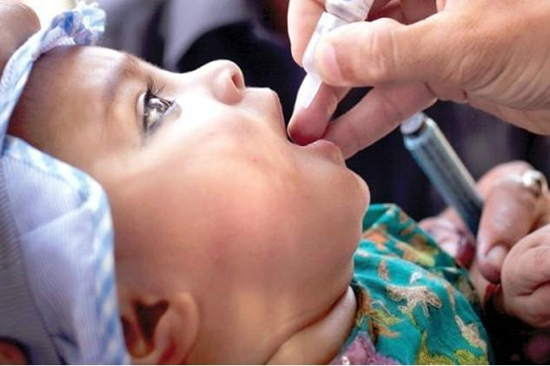

Pulsed vaccination
Attempt to synchronize effect of vaccination across subpopulations
Strong synchronized reductions hopefully drop things to zero
Common for polio

Slide 23
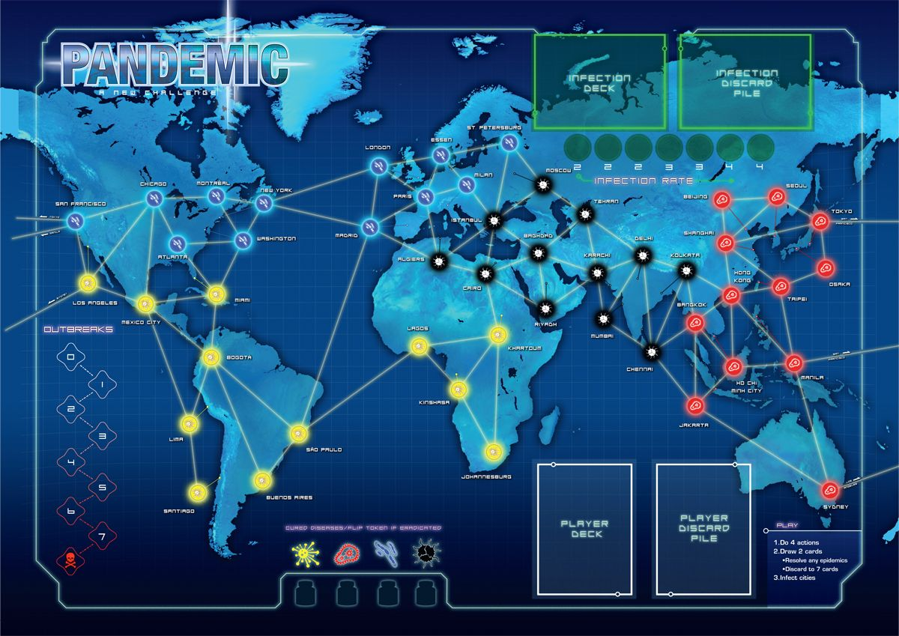
Connectivity between places: Usually more than just a few patches

Slide 24
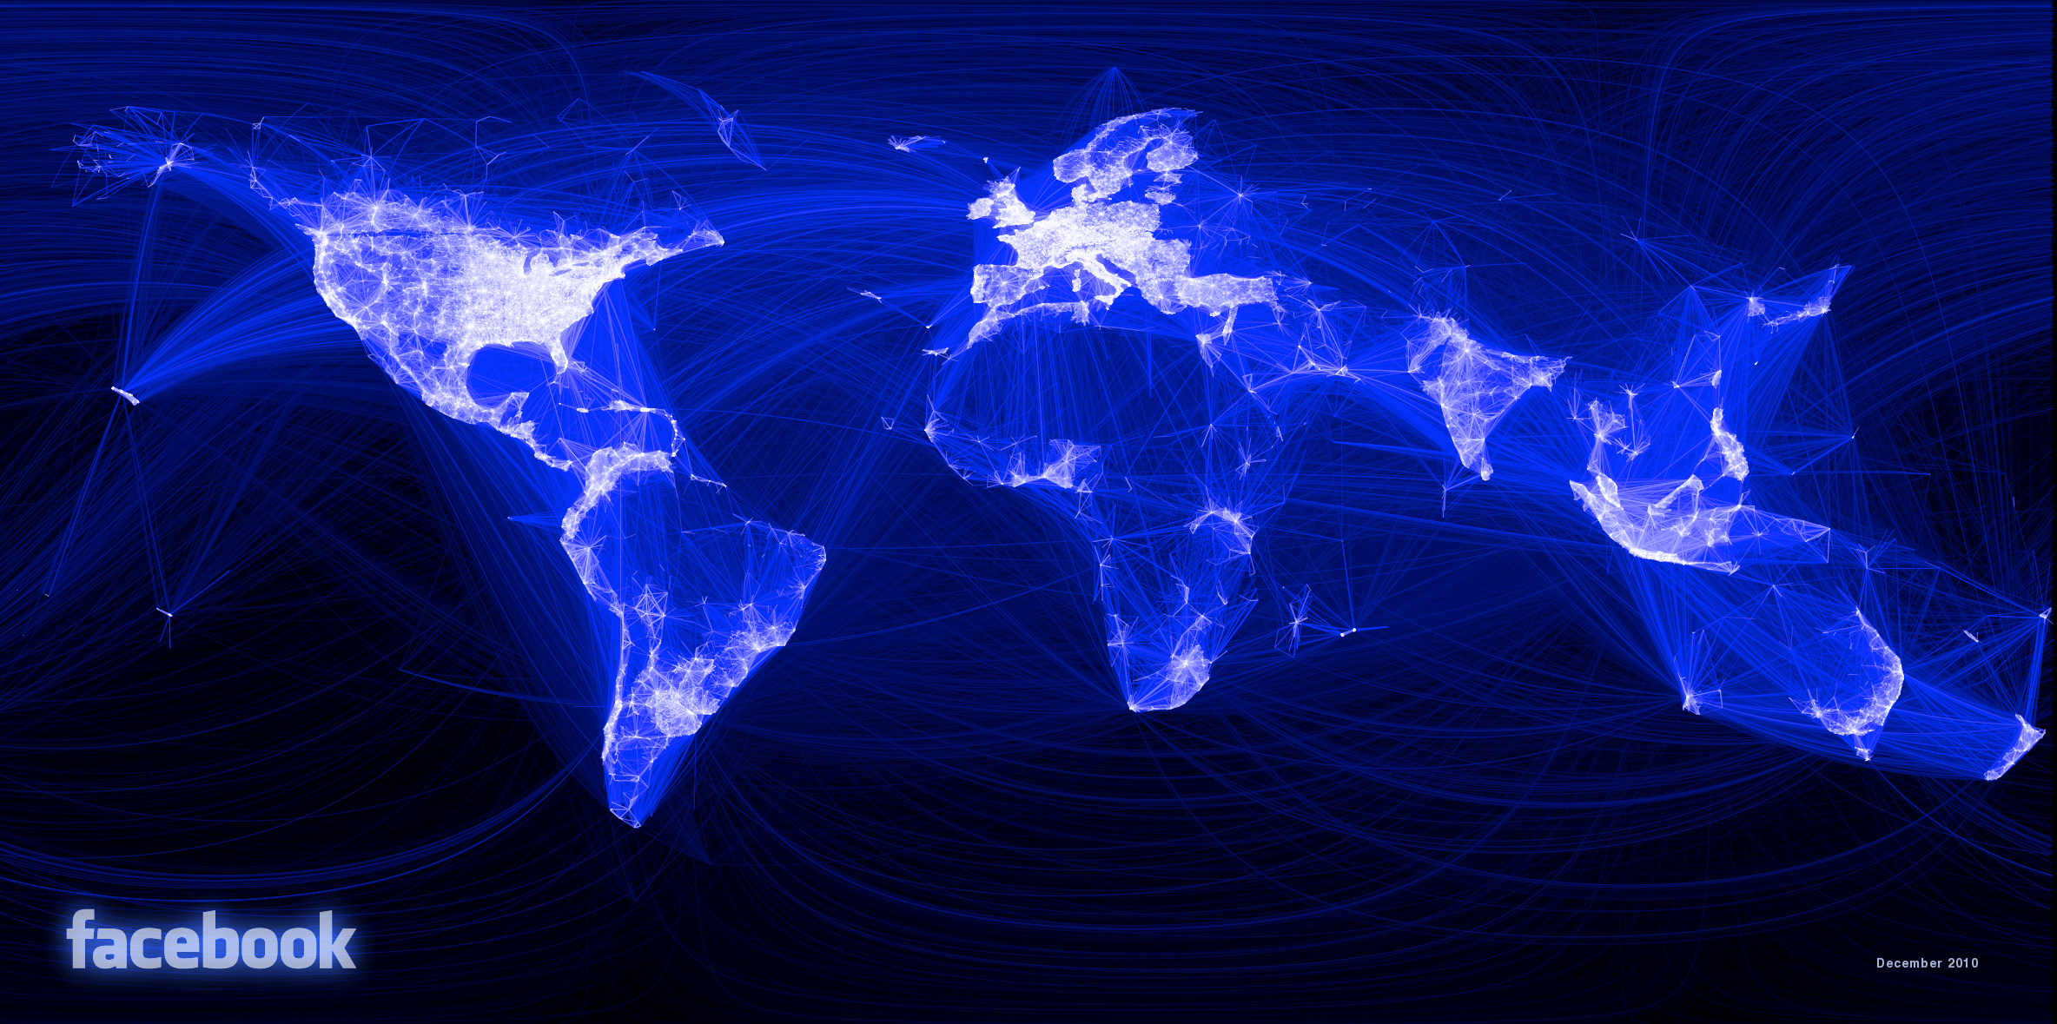

Slide 25
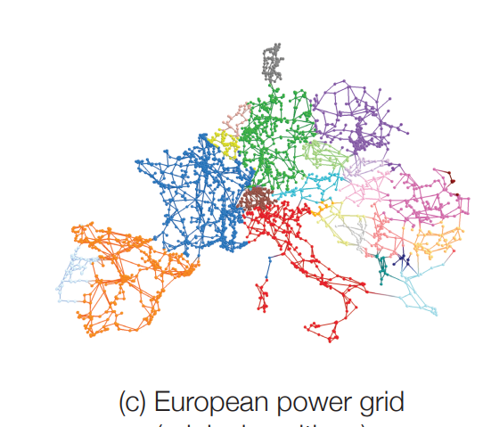
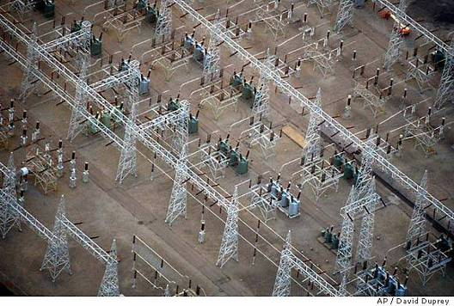
Network analysis
Commonly, complex networks form
Analyzing the structure of the network can be critical:
Power networks: Which substations are most important?

Slide 26
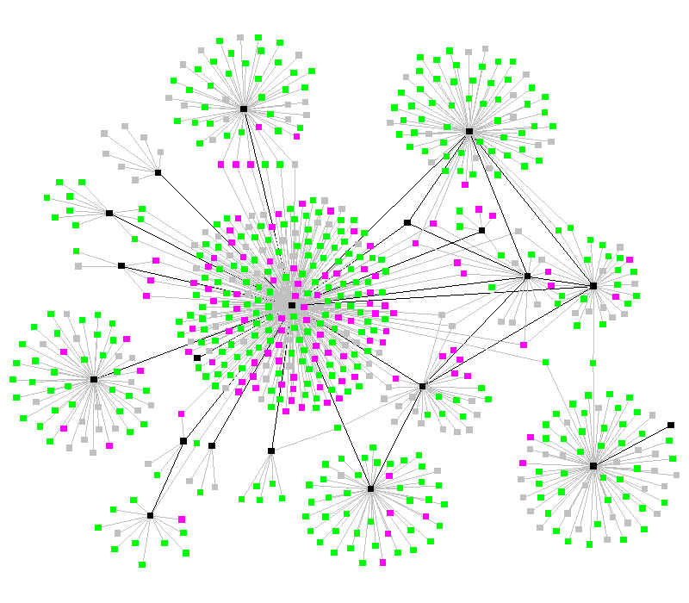
Network analysis: Infectious disease
Commonly used to understand which places/individuals are most important for disease control effort
Nodes can represent individuals or communities
TB outbreak in SW USA: Black nodes are infectious, pink nodes represent exposed, green represent susceptible.

Slide 27
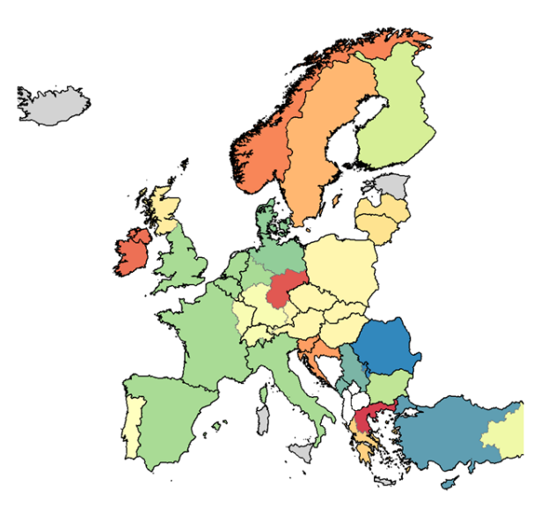
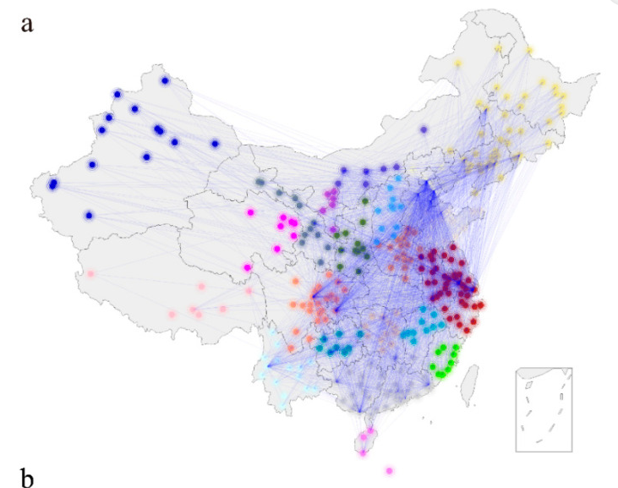
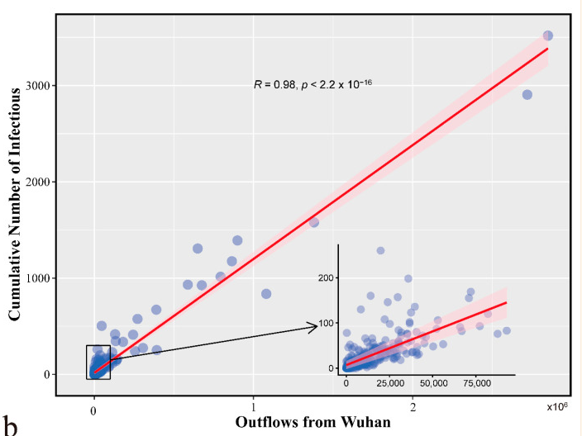

Slide 28
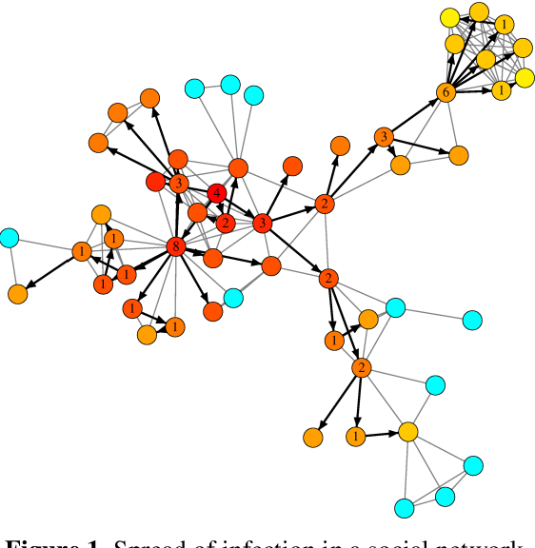
Network dynamics
Important for “betweenness”
Well-connected community
Some areas will become “central”
Will tend to get disease first
Most important for control
Various types of “centrality”
Well-connected in general: Diseases will tend to travel through here
“Betweenness” centrality: Disease has to travel through this place to get to other groups
Fundamentally, about where disease goes next
Will exhibit “wave” behavior and ”source-sink” dynamics

Slide 29
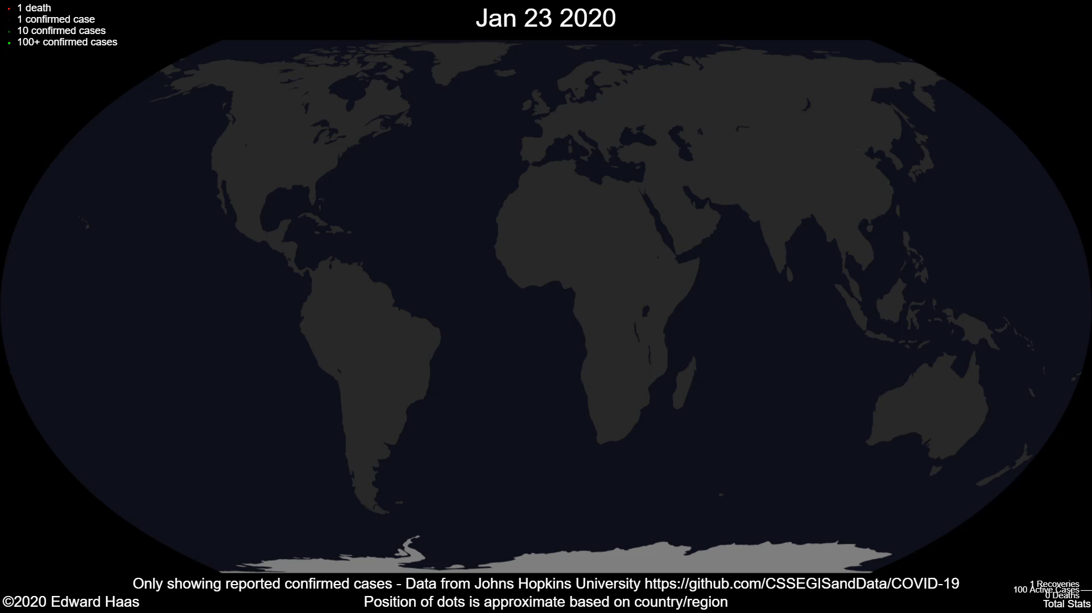

Slide 30
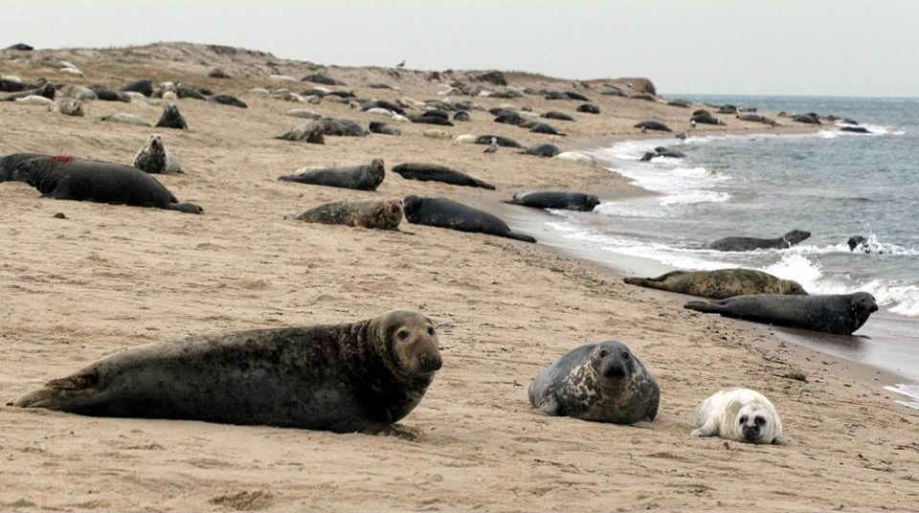
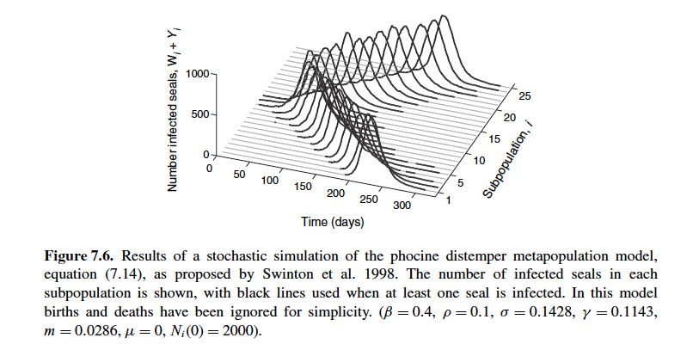
Wave dynamics: Phocine distemper virus
Virus that created an outbreak in seals in 1988—decimated seal populations
Social groups within very large colonies—limited mixing
Initial spread occurred over a year, and spread out of subpopulations over time

Slide 31
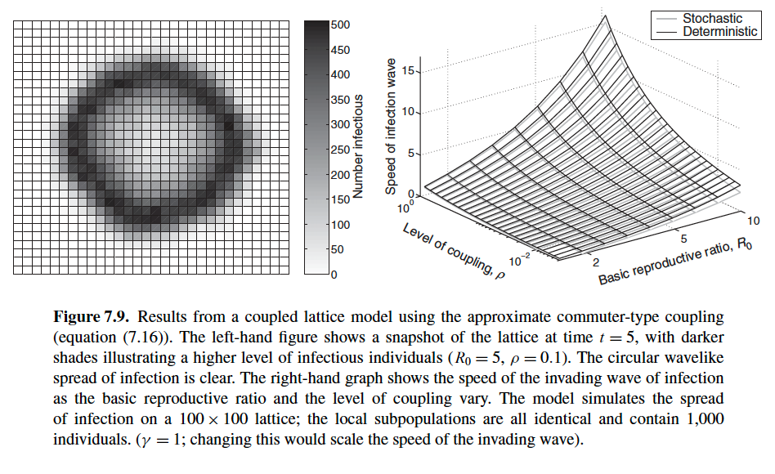
Wave speed
In general, spread depends on two factors:
Interconnectedness and reproductive number

Slide 32
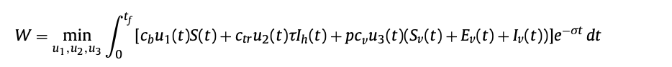
Optimal control
Often, there are public health and economic considerations
If we can only purchase so many bednets or treatments, how should we allocate them?
Can these considerations be quantified as a function that we would like to minimize?
Objective function: Summarizes the overall “cost” of cases + implementing new interventions

Slide 33
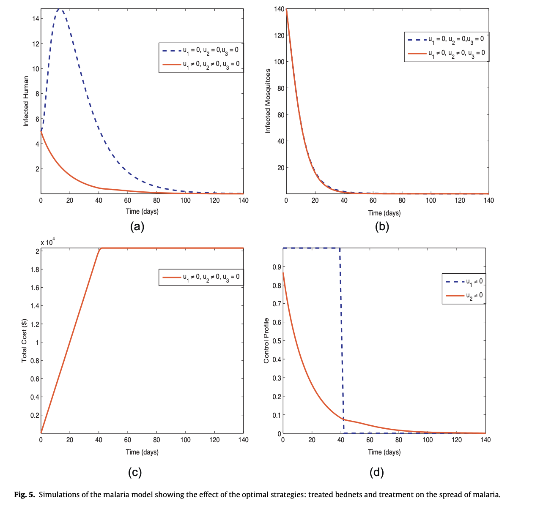
Optimal control theory
Determine ways to minimize the objective function over space and time
Commonly used to optimize placement of interventions across space

Slide 34
Spatial models
Lots of ways to incorporate space into a model: Has often key implications
Synchronized or strong connections means more likely to get synchronized epidemics, but also synchronized extinction
Affects control strategies like pulsed vaccination
Connectivity also often goes across longer distances/many patches
Reproductive number and connectivity influences wave speed, or the potential spread of an epidemic
Network and source sink dynamics… to be continued

Slide 35
Worksheet

